Slide 1
NAVIMOON: performance and characteristics of GNSS spaceborne receiver in representative lunar orbit
ION GNSS+ 2023
Denver, Friday 15th Sept
Session C5: GNSS Applications in Space
Pietro Giordano, ESA Michele Scotti, SpacePNT
Ben Kieniewicz, EECL
Anais Delepaut, PoliTo
Richard Swinden, ESA
Cyril Botteron, SpacePNT
Javier Ventura-Traveset, ESA
ESA UNCLASSIFIED - For Official Use

Slide 2
Lunar orbit type
Notes:
Cislunar missions can adopt many different types of orbits and LunaNet/Moonlight service providers will most likely focus their navigation services on the lunar surface and in low lunar orbit, leaving many other obits with limited in-situ navigation services.
The current approach is to rely on Earth ground station, leading to significant costs (not all the stations can communicate and range with missions around the Moon) and difficult planning do to the high number of deep space missions that share the same infrastructure (e.g. some data from JWST had to be delayed several days due to the ongoing Artemis 1 mission).

Slide 3
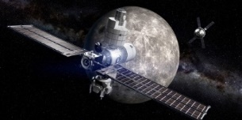
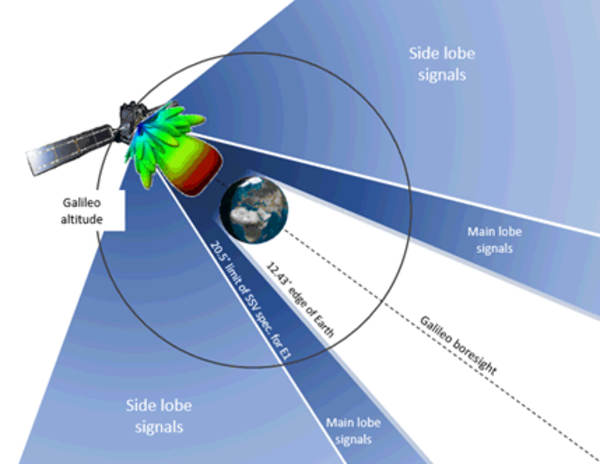
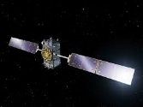
Is it possible to navigate with GPS and Galileo from the Moon?
Some key challenges
very low signal levels of GNSS signals (large distances and mostly coming from antenna sidelobes);
Very poor geometry – high DOP
limited access to navigation data;
Notes:
Usual explanation of the complexity of lunar GNSS

Slide 4
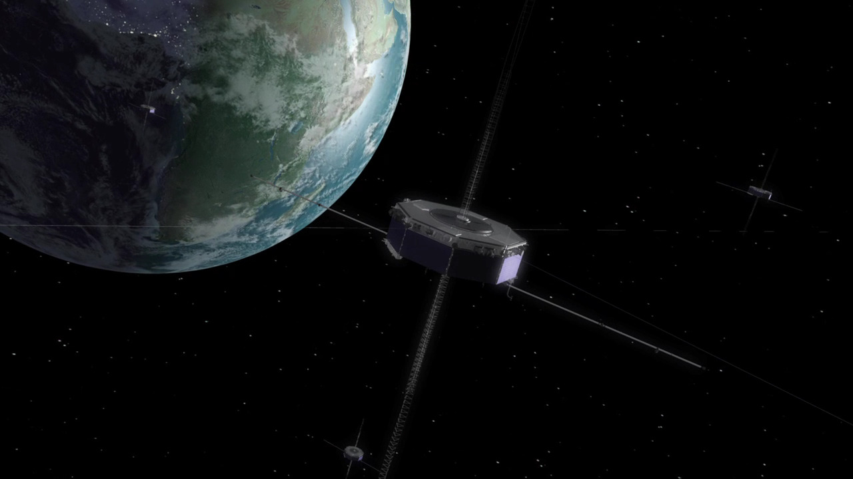
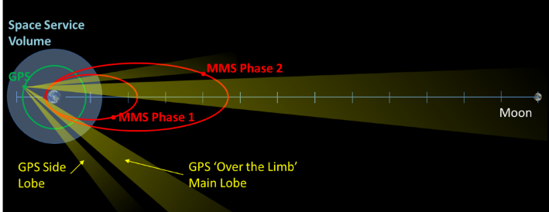
NASA MMS mission
In April 2019, the NASA MMS orbit Navigator set “Guinness world record” for the highest reception of signals and onboard navigation solutions by an operational GPS receiver in space (29 Re – 187.166 km half Earth-Moon distance) with excellent performances.
Yet, several potential receiver/system improvements are possible:
Tracking Threshold ~ 23 dB-Hz ( ~ today we estimate 15 dbHz is reachable)
Antenna Gain ~ emispherical 6.5 dBi (today ~14-15 dBi reachable)
GPS-only (GPS/Galileo combined as baseline)
L1 single frequency (L1/L5 dual frequency as baseline)
Notes:
Magnetospheric Multiscale Mission (MMS), launched in March 2015, investigates how the Sun’s and Earth’s magnetic fields connect and disconnect, known as magnetic reconnection.
Mission.
The four identically instrumented MMS spacecraft fly in an adjustable pyramid-like (tetrahedron) formation that enables them to observe the three-dimensional structure of magnetic reconnection. Four identically instrumented spacecraft measure plasmas, fields, and particles.
MMS will establish knowledge, methods and technologies applicable to future space weather missions and the future growth and development of space weather forecasting.

Slide 5
ESA Roadmap vision for Lunar Navigation Services
Phase 1: Use of Existing GNSS Systems (2023 – 2027) | Phase 2: Moonlight NAV Initial Services (2027 – 2035) | Phase 3: Moonlight NAV enhanced services (2035 – onwards)
Preliminary Lunar PNT services Adequate for Earth-to-Moon transfer and Lunar orbit | Moonlight Lunar PNT services High improvement of lunar orbit PNT services PNT services for lunar landing and lunar surface on South Pole. | Enhanced Moonlight Lunar PNT services Full lunar surface coverage Improved PNT accuracy and availability services
Earth-based GNSS (Galileo and GPS) Use of high-sensitivity GNSS space receivers with directive antennas Lunar Pathfinder GNSS Payload IoD | Moonlight Lunar Navigation Satellites constellation GNSS-like services (Moonlight IOC-2027; Moonlight FOC 2030) MOONLIGHT / LCNS Initial Services | Enhanced Lunar Communication and Navigation Satellites constellation (Moonlight 2nd Generation) Additional satellites / Moon surface PNT Beacons / Local PNT Moon augmentations MOONLIGHT / LCNS: Enhanced Services
Notes:
ESA has established in 2019 a roadmap for lunar radio navigation services. The roadmap foresees 3 phases, the first one being the use of existing GNSS signals in cislunar space by means of highly sensitive GNSS spaceborne receivers. The lunar pathfinder experiment belong to this phase

Slide 6
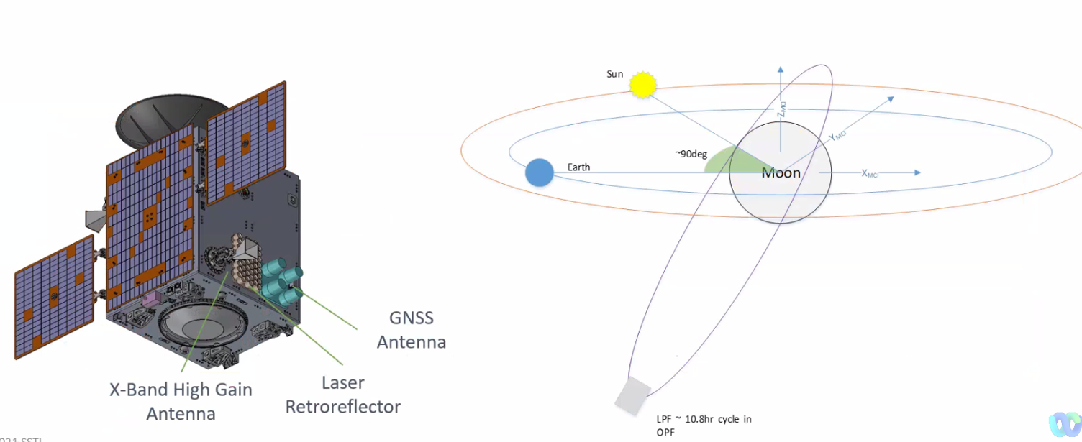
Lunar Pathfinder Satellite – First ever GPS/GALILEO reception on lunar orbit
Notes:
High level explanation of the LPF mission, covering data relay services, using ELFO orbit
High level description of the navigation experiment payloads, more details will follow in the next slides

Slide 7
GNSS Technology and Moon exploration: feasibility
Key issues for Lunar GNSS reception:
Use of:
advanced high-sensitive space receivers with low acquisition threshold
combined with advanced on-board dynamic filter (that considers the forces affecting the spacecraft orbits)
a directive medium gain GNSS antenna
Use GNSS multi-frequency and multi-constellation to maximize available signals
Other potential enhancing techniques (long-term ephemeris information; provide augmentation with GNSS ephemeris information at receiver; complement with additional ranging sources; etc)
Notes:
Usual slide explaining what are the techniques and technologies that will allow reception of GNSS signals in cislunar space

Slide 8
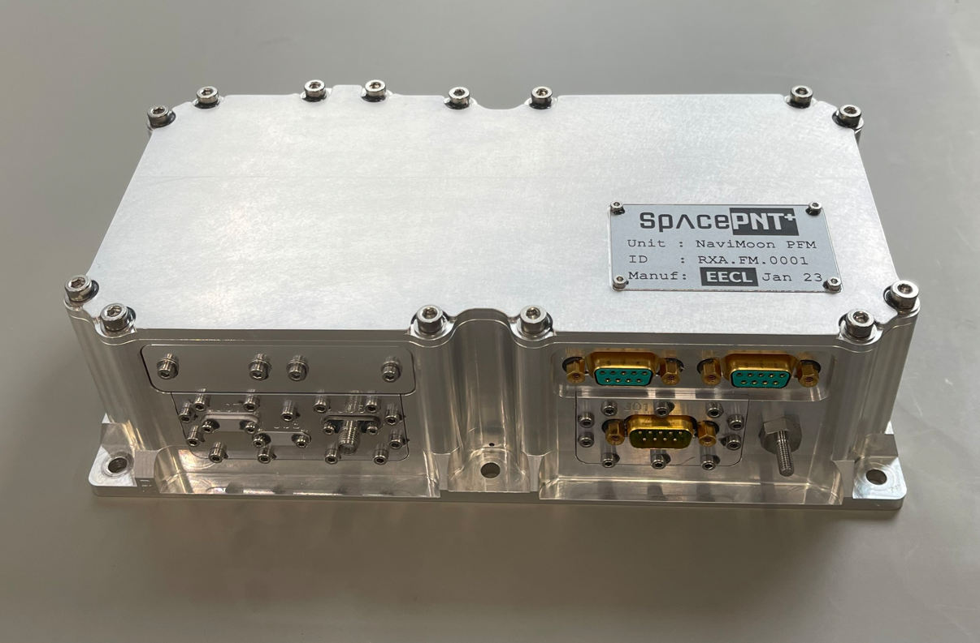
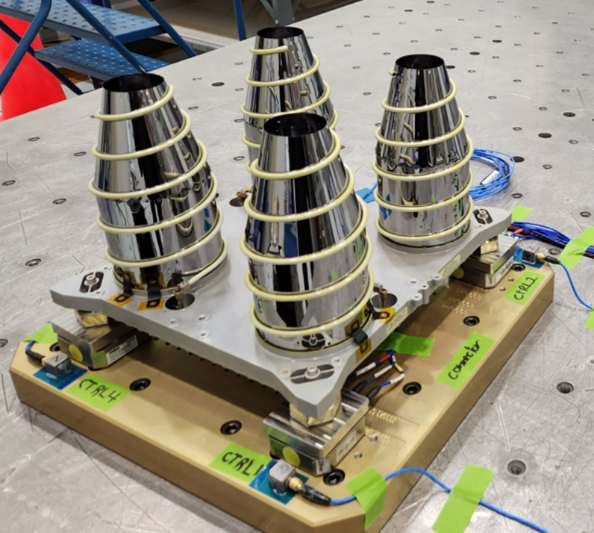
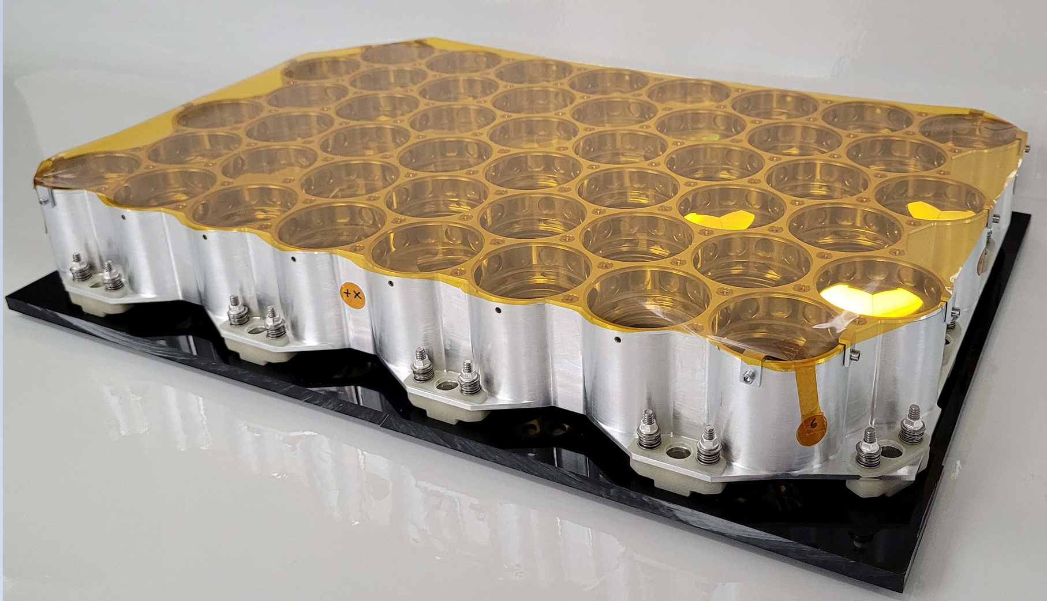
Lunar Pathfinder Navigation Payload In-orbit Demonstration All flight units now manufactured and tested
GNSS High-sensitive receiver Flight unit
GNSS Medium-Gain Antenna
Flight unit
Laser Retroreflector
Flight unit
Parameter | Value
Acquisition sensitivity | ~18dBHz
Tracking sensitivity | ~15dBHz
3D Position accuracy | < 100m RMS
3D Velocity accuracy | < 0.5 m/s RMS
Mass | < 1.4 Kg
Size | < 24x12x7cm
Power | < 10W
Constellations | GPS / Galileo L1/E1/L5/E5
Parameter | Value
L1 boresight gain | 15 dBi
L5 boresight gain | 15 dBi
Polarization | RHCP
Mass | ~2Kg
Size | 26x26x28cm
Notes:
More detailed description of the experiment payloads
Receivers + LNA developed by SPNT/EECL
Antenna developed by MDA
LRR provided by NASA

Slide 9
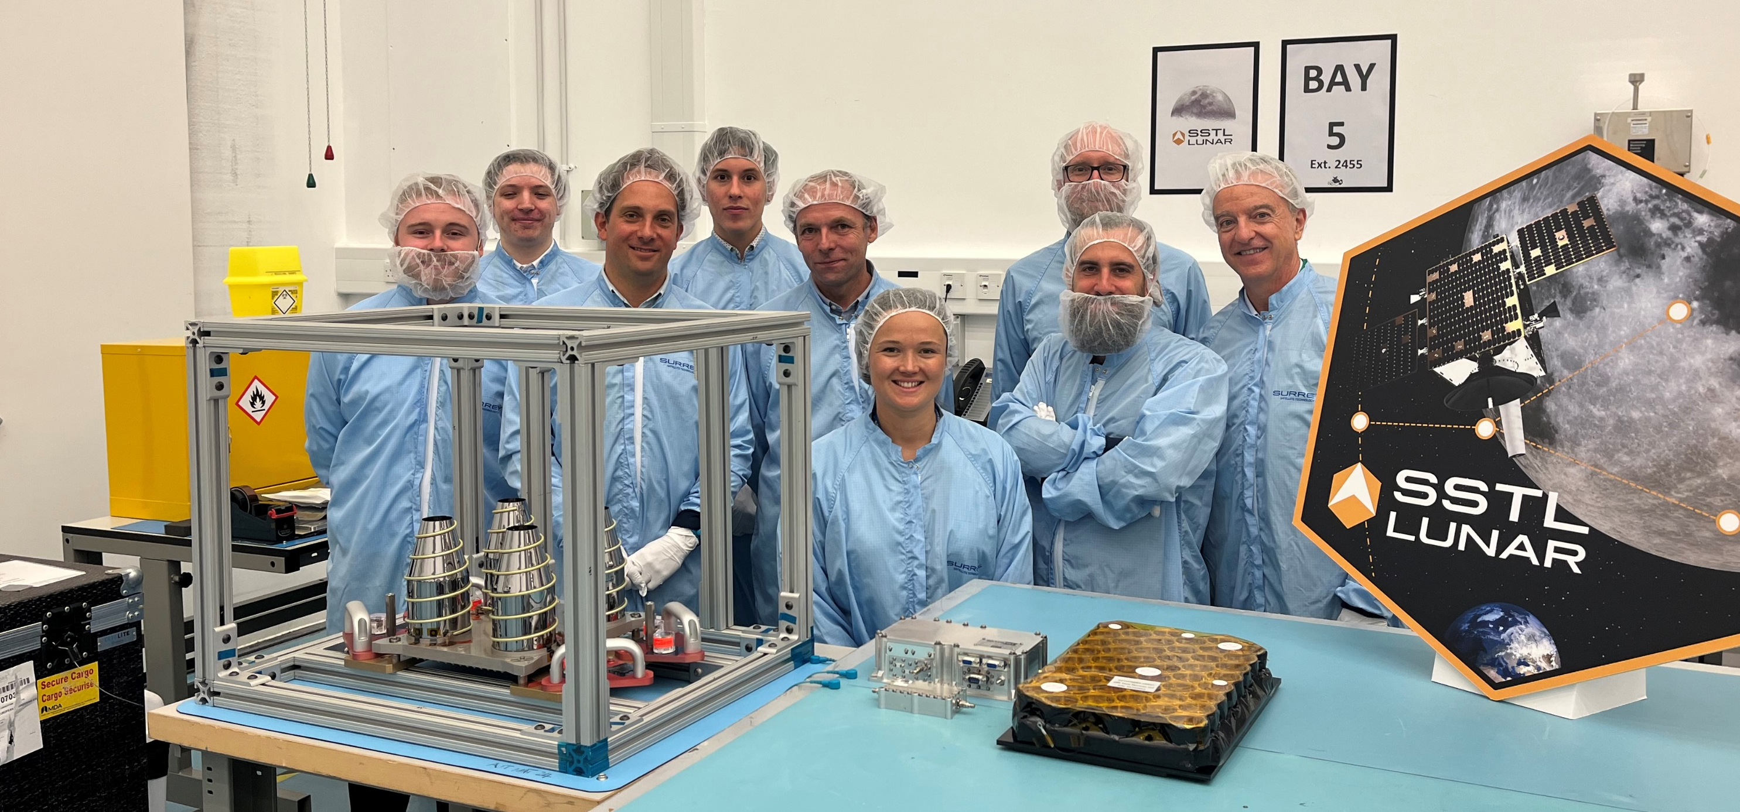
Lunar Pathfinder Navigation Payload In-orbit Demonstration All flight units delivered
Notes:
Successful delivery of all HW units to SSTL
SW development is under finalisation, targeting a SW-QR in November 2023
The performances shown in the next slides are preliminary and expected to improve with further tuning of the receiver SW (in particular the navigation filter).

Slide 10
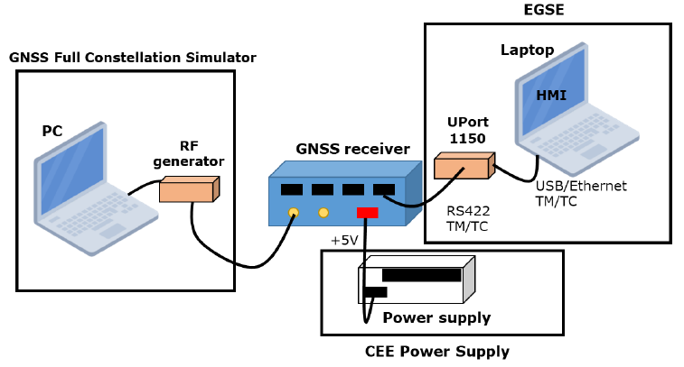
Functional and Performance test set-up
The receiver has been tested with Skydel and Spirent RFCS
The reference user trajectory has been generated with GMAT, using realistic dynamic models (tests performed in MTO and NRHO orbit)
Simulation power has been fine tuned to be representative of GPS and Galileo EIRP and Tx antenna gain pattern
Receiver antenna gain pattern has been simulated
GPS L1CA
GPS L5
Galileo E1
Galileo E5a
Notes:
The presentation will focus on the functional and performance testing of the receiver, not covering the environmental testing performance for the PFM
In these tests the receiver does not implement yet the spherical harmonics of the Moon gravity field (not relevant considering the distance from the Moon)
Testing with LPF orbit are currently ongoing

Slide 11
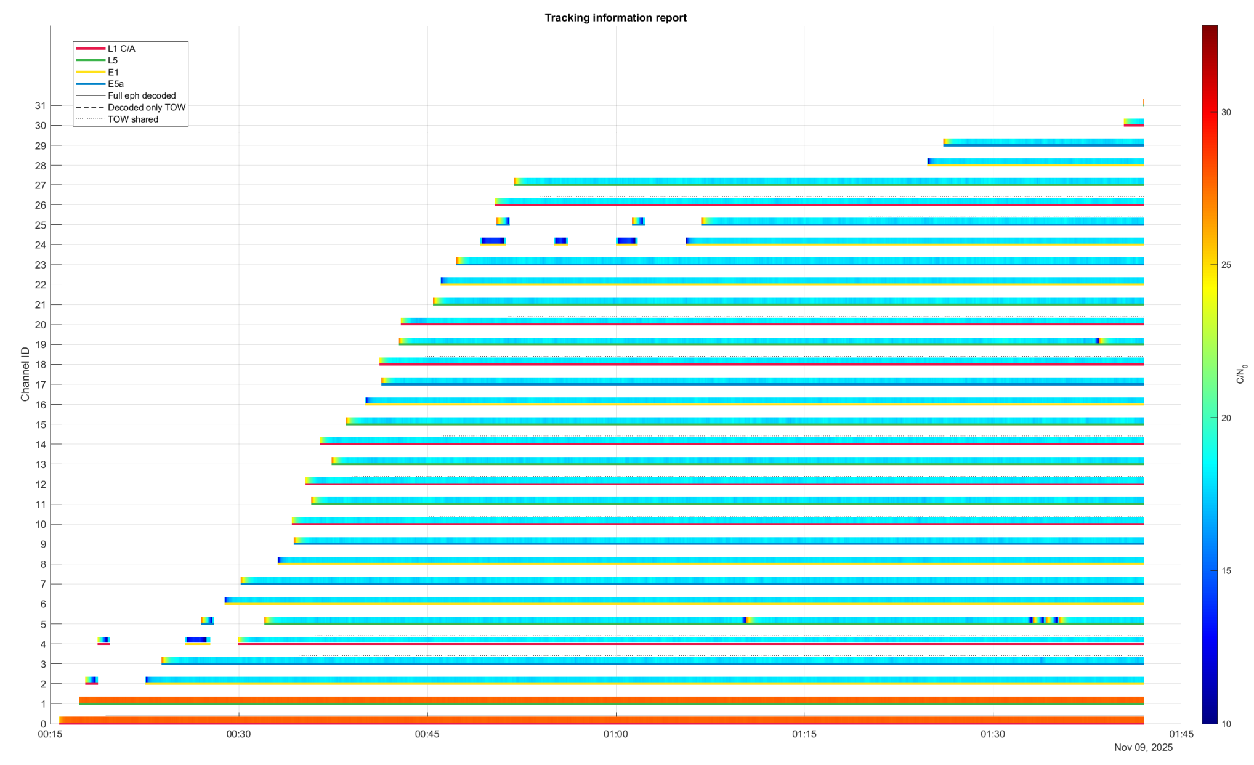
Acquisition sensitivity – real hardware in the loop test
NRHO w/ 18 dBHz isopower scenario
GPS L1CA
GPS L5
Galileo E5a
Galileo E1

Slide 12
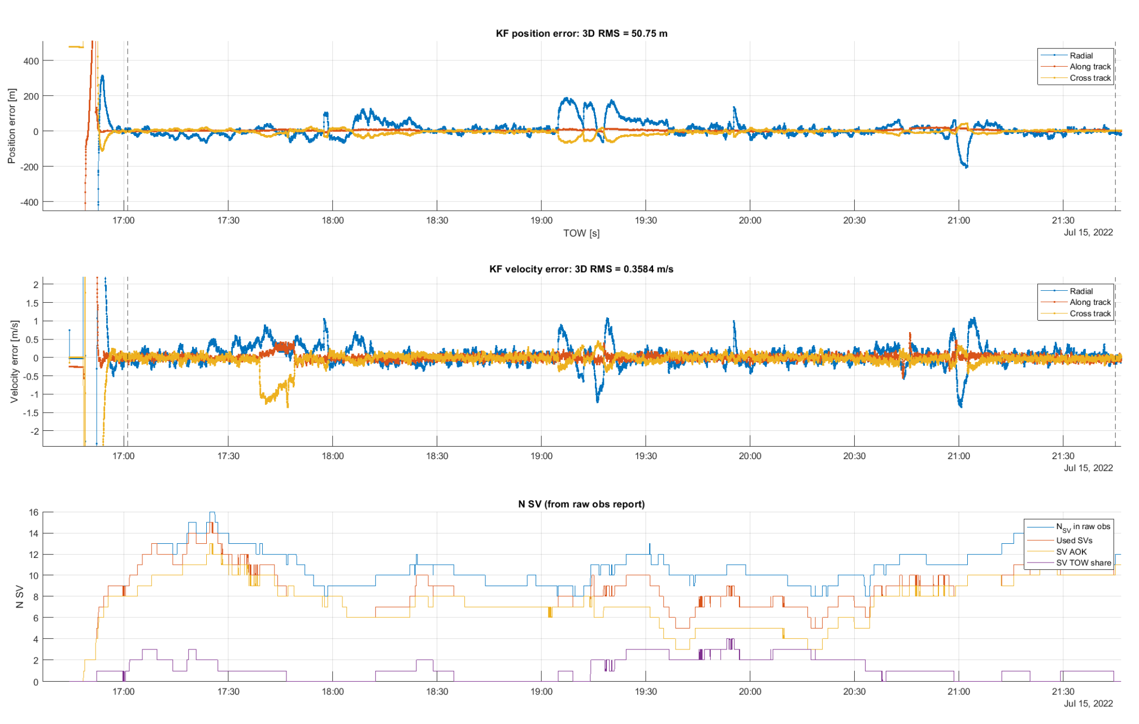
MTO – real hardware in the loop test
KF position error: 3D RMS = 50.7 m
KF velocity error: 3D RMS = 0.358 m/s
# SV
Notes:
Description of the performances in MTO trajectory
Signal power is higher than cislunar space: more satellites, lower noise, better geometry
Higher degradation is visible in the radial component mainly due to the use of OCXO clock (it is difficult to distinguish the radial component from the receiver clock contribution)
The filter is not fined tuned, so improved performances are expected

Slide 13
NRHO – real hardware in the loop test
KF position error: 3D RMS = 123 m
KF velocity error: 3D RMS = 0.28 m/s
# SV
Notes:
Performances in NRHO are very good, the impact of the clock instability seems higher (this is expected due to the worst geometry and the lower signal power).
Further tuning of the filter are expected to improve the performances

Slide 14
High level CONOPS for the experiment
The experiment will be conducted in slots of 4-5 days of duration
The receiver configuration will be uploaded at the beginning of the slot and during the experiment the receiver will be fully autonomous (without any external aiding)

Slide 15
Conclusions
The PNT experiment in Lunar Pathfinder aims to be the first ever demonstration of use of Earth GNSS for lunar orbit determination (and time synchronisation).
Accuracy around 100m 3D RMS has been demonstrated with real hardware in the loop. Below 100m performances are expected with proper fine tuning.
Flight hardware has been qualified and delivered to SSTL
The mission will also demonstrate the use of 3 independent ranging sources (GNSS, X-band, LRR) for precise orbit determination of lunar satellites
Ongoing cooperation with NASA and Jaxa

Slide 16
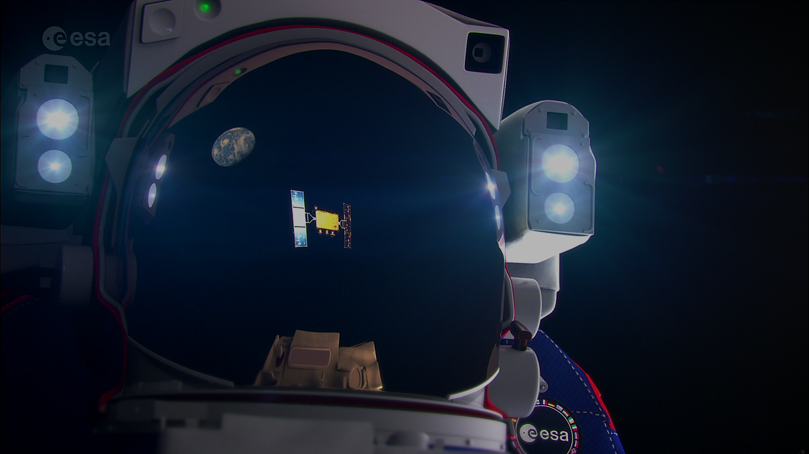
Contacts: Pietro.Giordano@esa.int michele.scotti@spacepnt.com
Thank you !!

